Slide 1

Green Software Engineering
By. Chen Zeng, Luis Ernesto, Anthony Garcia

Slide 2
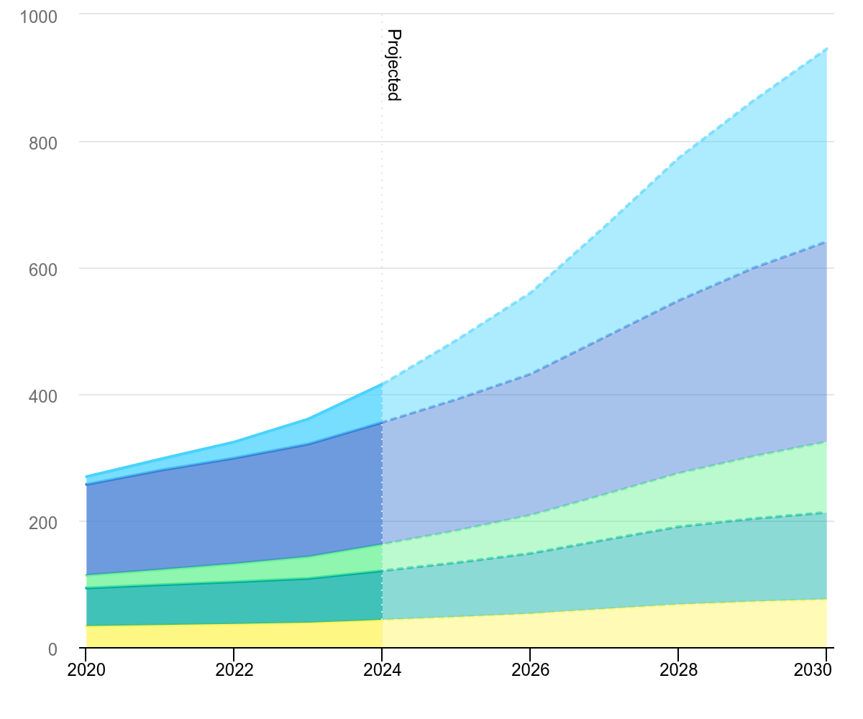
Global data centre electricity consumption by Equipment

Slide 3
What is Green Software Engineering?
Green software engineering is the practice of designing, developing, running, and maintaining software in ways that minimize its environmental impact by reducing energy consumption, carbon emissions, and resource waste.

Slide 4
Examples of Software Engineering Waste
According to the International Energy Agency, a traditional ChatGPT request was estimated to use around ten times more electricity than a Google search, although actual consumption varies depending on the model and task.
Another concern is electronic waste. AI infrastructure requires specialized chips and servers, which eventually need to be replaced or recycled.

Slide 5
What developers can do
• Energy efficiency: do the same job with less computing
• Carbon awareness: run heavy tasks when the electricity is cleaner
• Hardware efficiency: keep devices and servers longer
• Measurement: "What you can't measure, you can't improve"
Source: Green Software Foundation

Slide 6
Start with our own code
• Since 2024, an ISO standard measures software's carbon: the Software Carbon Intensity (SCI) specification
• June 2026: the UN asked AI companies to disclose their carbon, water and land footprints
Sources: Green Software Foundation; UN University

Slide 7
References
IEA (2025), Global data centre electricity consumption, by equipment, Base Case, 2020-2030, IEA, Paris https://www.iea.org/data-and-statistics/charts/global-data-centre-electricity-consumption-by-equipment-base-case-2020-2030, Licence: CC BY 4.0
https://news.un.org/en/story/2026/06/1167658
Green Software Foundation (n.d.), Introduction, https://learn.greensoftware.foundation/introduction
Green Software Foundation (2024), SCI specification achieves ISO standard status, https://greensoftware.foundation/articles/sci-specification-achieves-iso-standard-status/
UNU-INWEH (2026), UN Secretary-General launches AI Environmental Transparency Initiative, https://unu.edu/inweh/news/un-secretary-general-launches-ai-environmental-transparency-initiative-calling-ai
https://news.mit.edu/2026/how-data-centers-can-better-manage-energy-use-0626

Slide 8
What is currently being done to address AI’s environmental impact?
UNESCO Recommendations on the Ethics of Artificial Intelligence, - addresses its environmental impact as well as its ethical application.
Companies are developing smaller models, specialized AI chips, model quantization, pruning, and more efficient inference methods. These approaches reduce the computing needed for many AI tasks.
Data centres are adopting direct-to-chip liquid cooling, better airflow management, heat reuse, and alternative cooling systems. Some facilities also use reclaimed water instead of drinking water

